Slide 1
UltraLite Coding: Banqi
Nicholas Walter
Tyler Hogenson
Spencer Lofing
Ben Finnerty
Max Maier

Slide 2
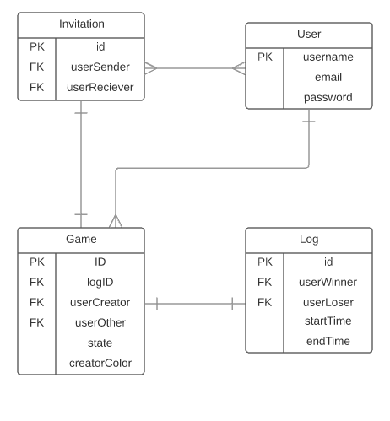
Entity Relationship diagram

Slide 3
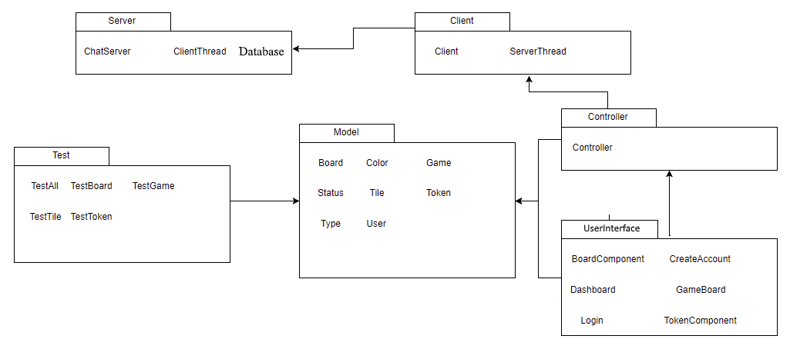
Package Diagram

Slide 4
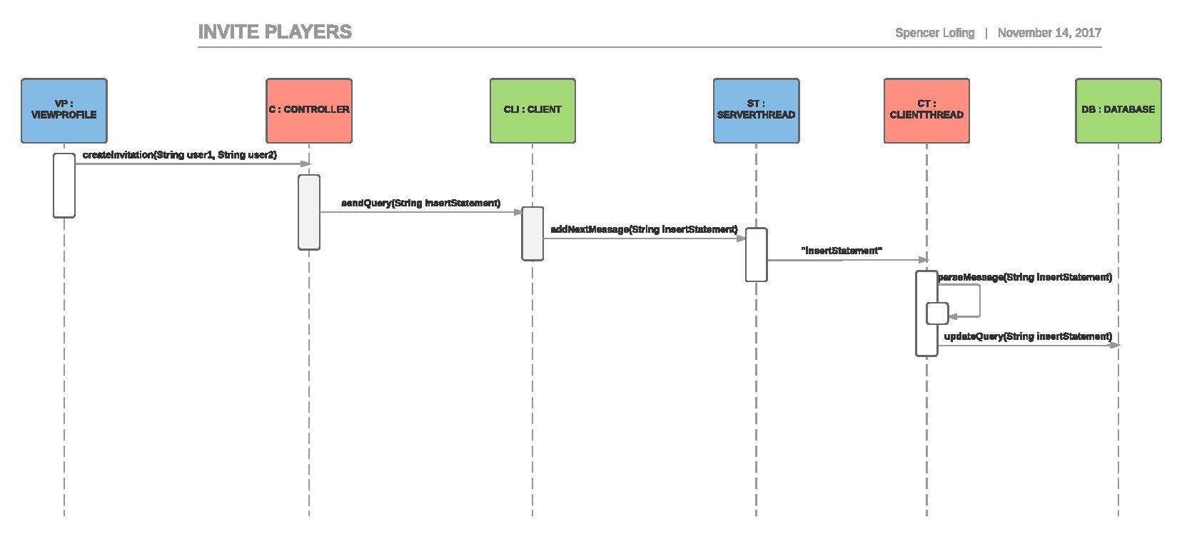
Updated sequence diagrams

Slide 5
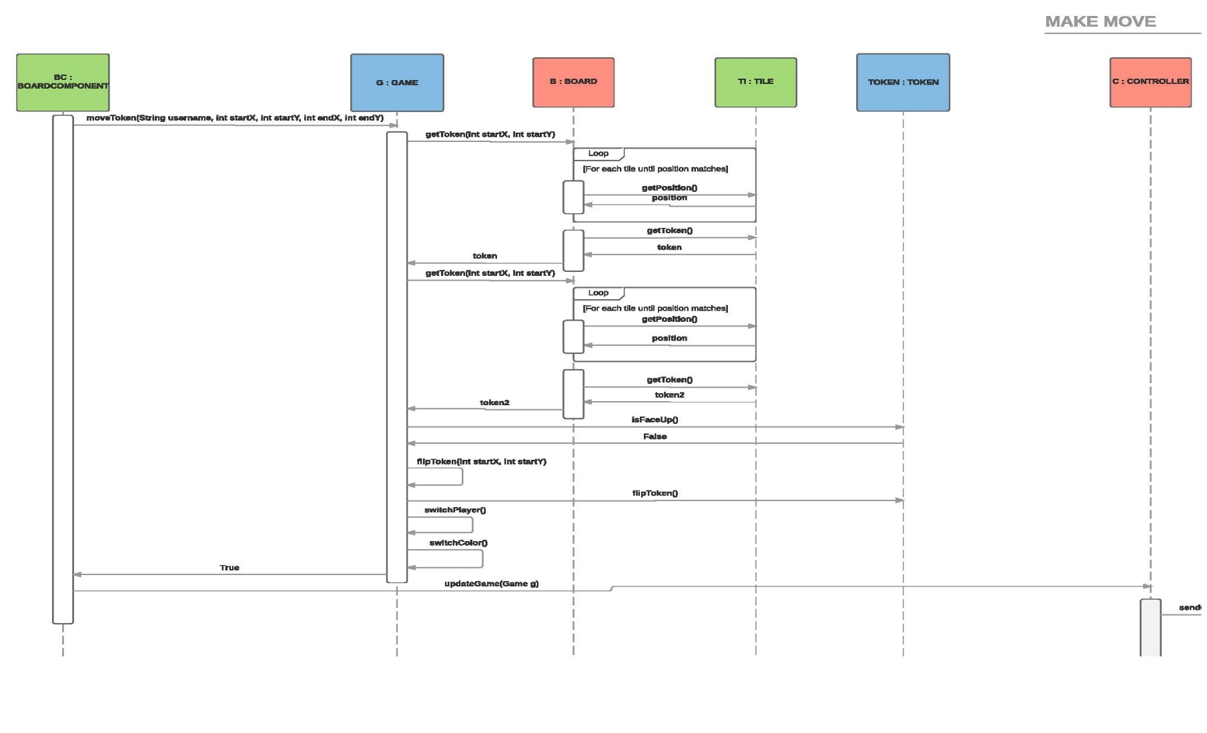
Updated sequence diagrams

Slide 6
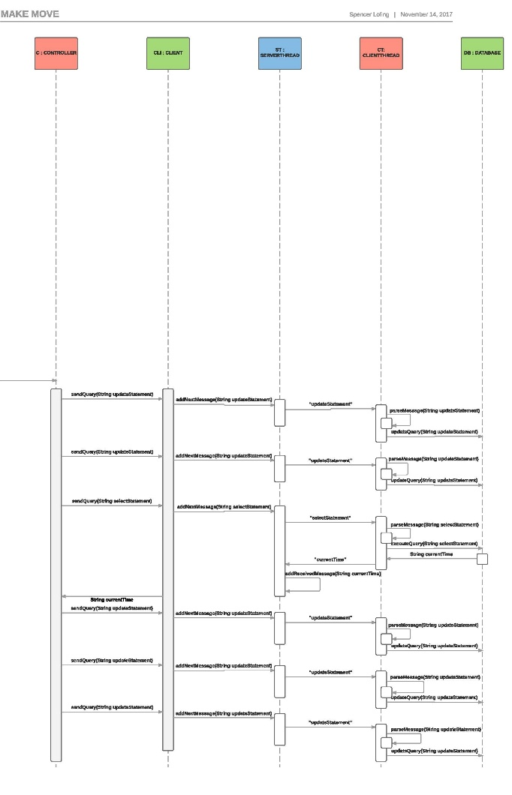
Updated sequence diagrams

Slide 7
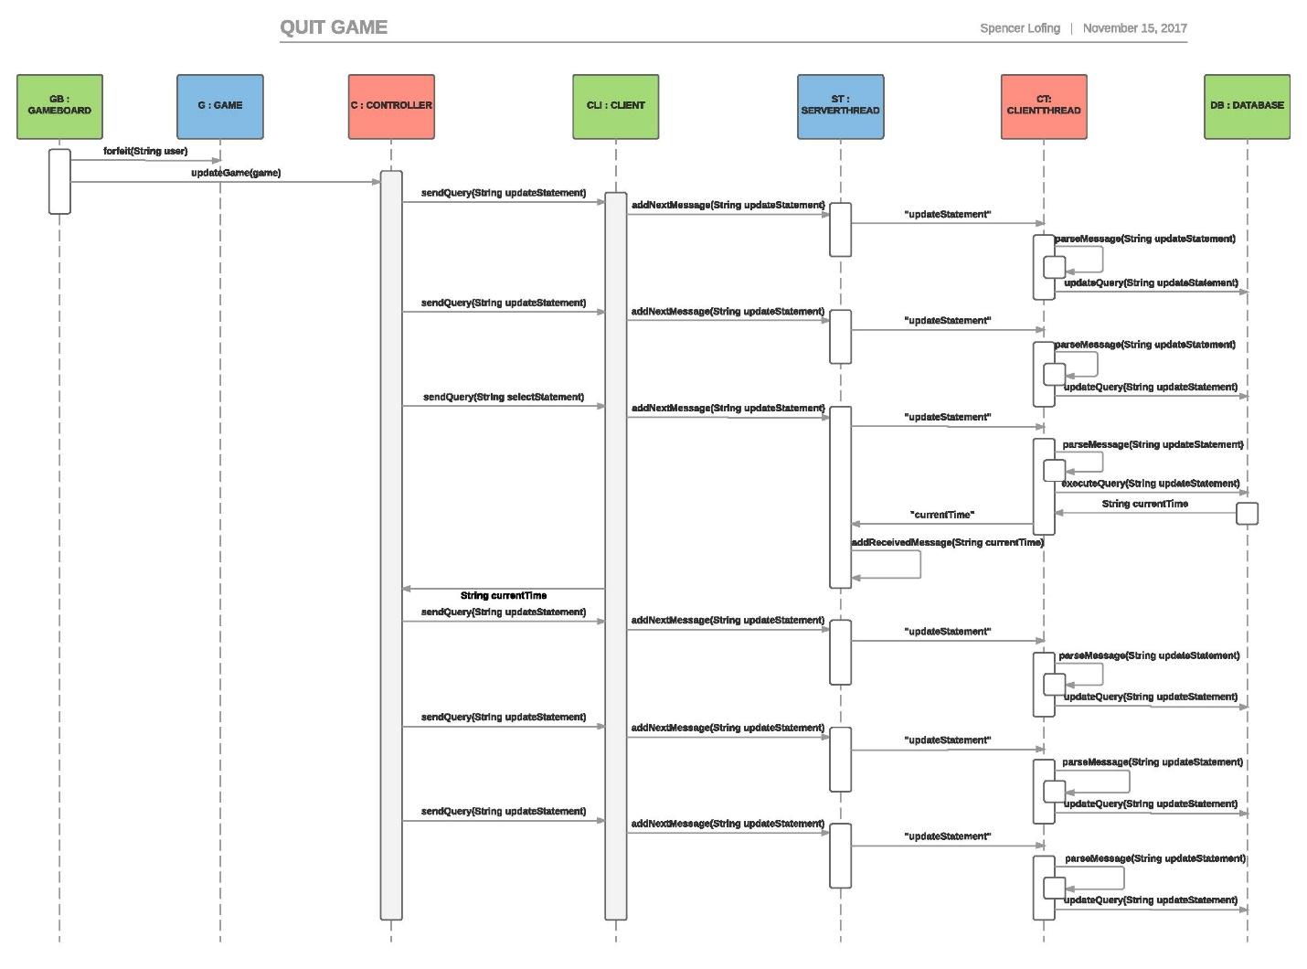
Updated sequence diagrams

Slide 8
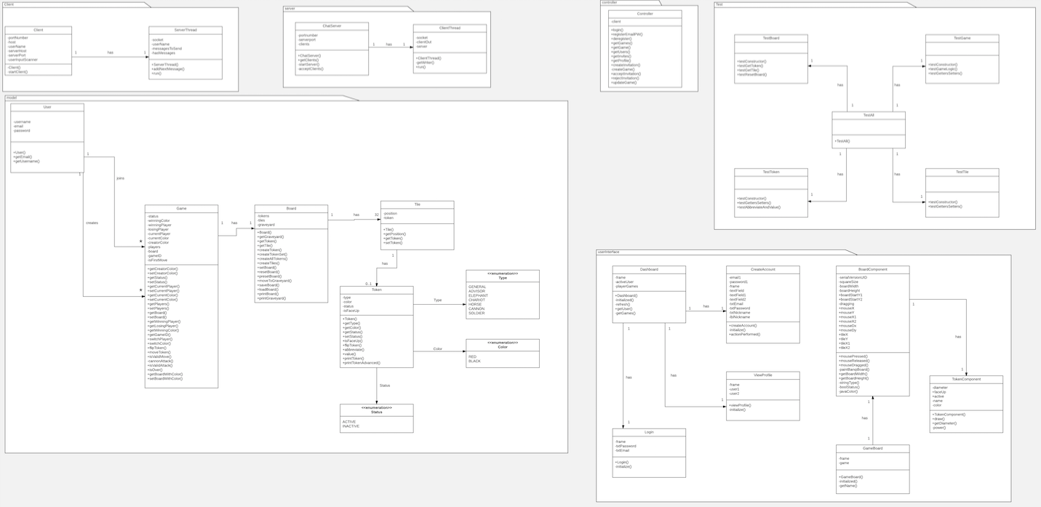
Updated Design Class Diagram, Overview

Slide 9
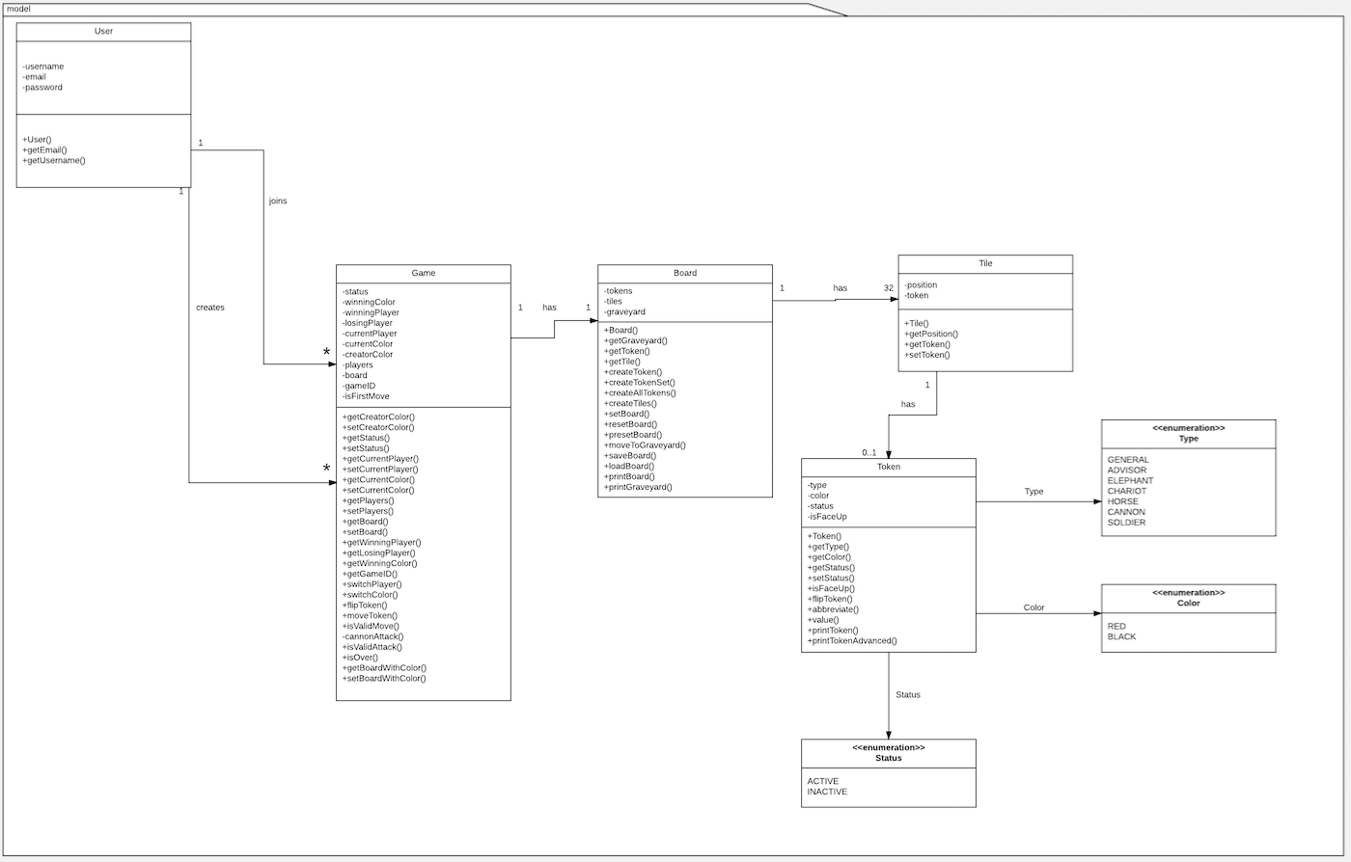

Slide 10
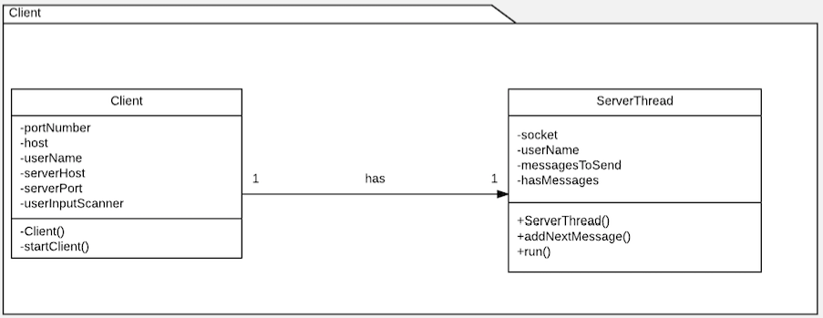
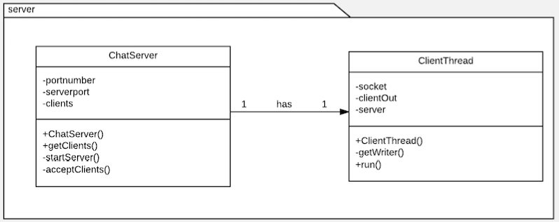

Slide 11
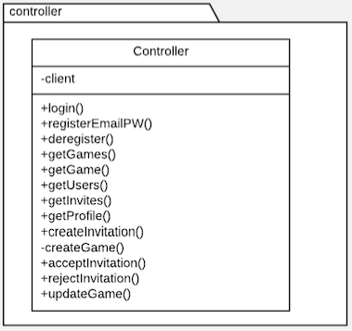
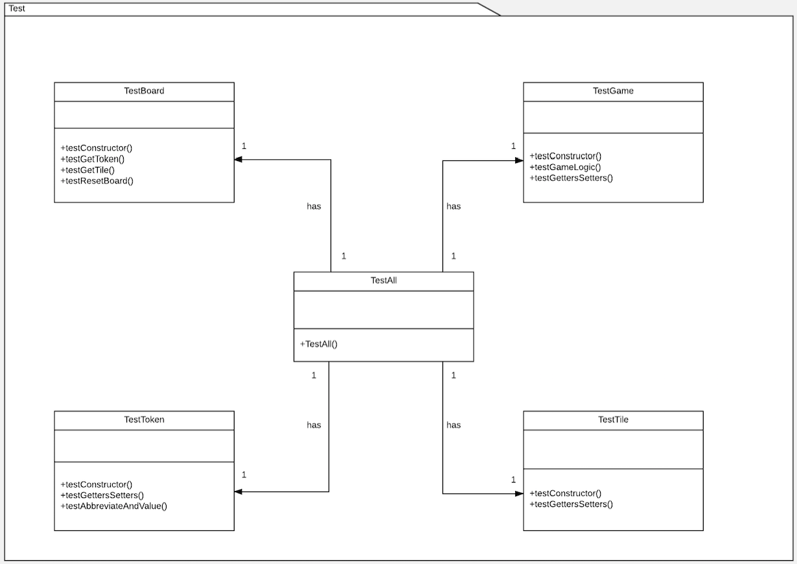

Slide 12
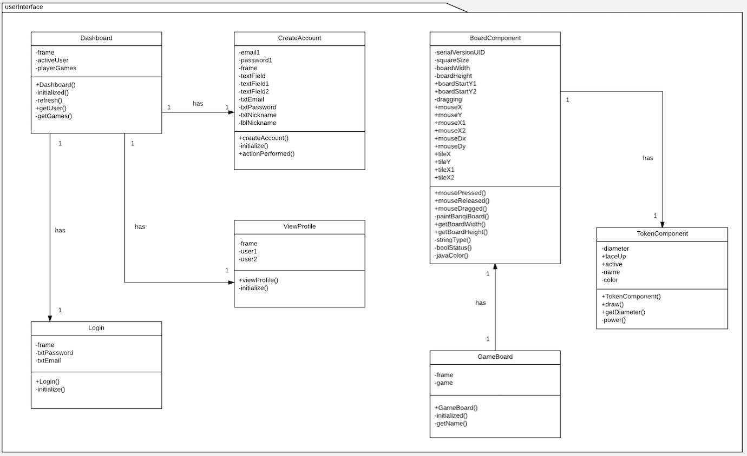

Slide 13
Refactoring and Design pattern list
Separated classes into Model-View-Controller packages
Implemented Façade Pattern by creating a few other packages
Used Extraction to reduce reuse of code within classes
Rearranged classes to have Low Coupling
Removed Log.java, Profile.java, and Invitation.java

Slide 14
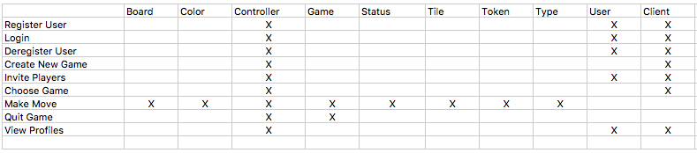
Traceability Link Matrix

Slide 15
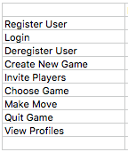
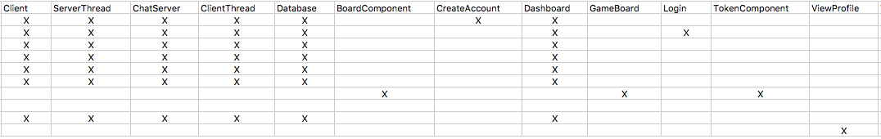

Slide 16
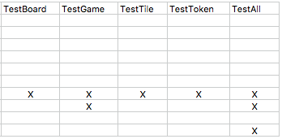

Slide 17
DEMO

